Slide 1

IBM DATA ANALYST CAPSTONE PROJECT
Analysis on Emerging Technology Skills and Trends

Slide 2

OUTLINE
Executive Summary
Introduction
Methodology
Results: Visualization – Charts
Dashboards
Discussion: Findings & Implications
Conclusion
Appendix

Slide 3
EXECUTIVE SUMMARY
Data contextualization and analysis
Methodology description
- Data gathering from IBM site
- Data analysis by python and MySQL
- Data visualizations using IBM Cognos
Results supported with graphs and trends
Discussion of overall finding and implications regarding the results
Final conclusions of the study was carried out

Slide 4
INTRODUCTION
The presentation report uses data analytics to highlight current project trends in need for skills related to programming language, databases and web frames.
The following were investigated using the data provided
- Programming languages currently in demand
- Database skills in demand
- Popular IDEs or WebFrames currently in demand and in future
Target audience for this research are IT professionals, HR managers and anyone interested in IT sector.

Slide 5
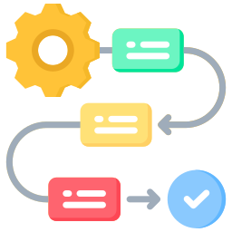
METHODOLOGY
Collect survey data and understand the data
- Web scrapping, APIs, request libraries
Data wrangling
Exploratory Data Analysis (EDA)
- Analyze data distribution
- Handling outliers
- Correlations
Data visualization
- Highlight distribution of data, relationships and comparison of data
Creation of dashboards

Slide 6
RESULTS

Slide 7
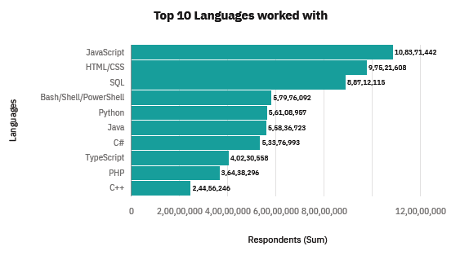
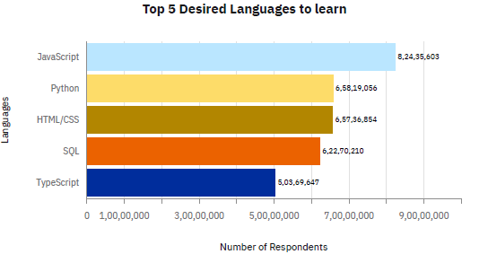
PROGRAMMING LANGUAGE TRENDS
CURRENT YEAR
NEXT YEAR

Slide 8
Programming Languages Trends – Findings and Implications
Findings
Javascript, HTML, SQL, Shell languages and Python are the most used languages currently.
Javascript, HTML, SQL, Python and Typescript will be the most used languages in future years.
Python will have more demand than SQL in next years
Implications
Javascript and HTML are used for web development which means that web development skill has the highest demand.
Python is gaining more traction due to increase in demand for AI and ML skills
SQL is the most relevant language for data professionals.

Slide 9
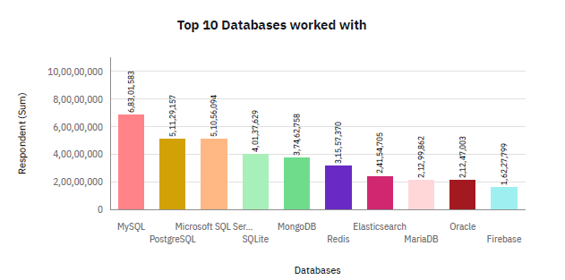
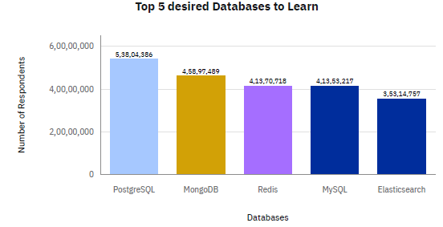
DATABASE TRENDS
CURRENT YEAR
NEXT YEAR

Slide 10
Database – Findings and Implications
Findings
MySQL, Microsoft SQL server, PostgreSQL, SQLite and MongoDB are the top 5 most used databases at the moment.
Redis and Elasticsearch are relatively new tools and are set to gain more traction in the new IT space.
PostgreSQL remain at the top of list in both currently used and future trend databases.
Implications
PostgreSQL is the most desired database to learn next year, even though it ranks second in current usage. This might indicate a growing preference for open-source relational databases that offer versatility and scalability.
Companies still prefer open source databases.
Despite its current lower usage, the strong interest in learning Elasticsearch suggests a growing trend toward full-text search engines and analytics tools in modern applications.

Slide 11
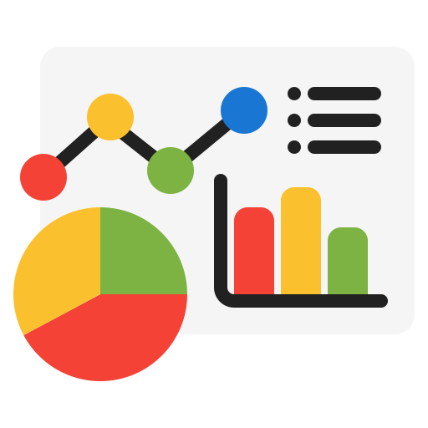
DASHBOARD LINK
https://us3.ca.analytics.ibm.com/bi/?perspective=dashboard&id=iDCB4187228F54F5DB655A1B27CEC4820&objRef=iDCB4187228F54F5DB655A1B27CEC4820

Slide 12
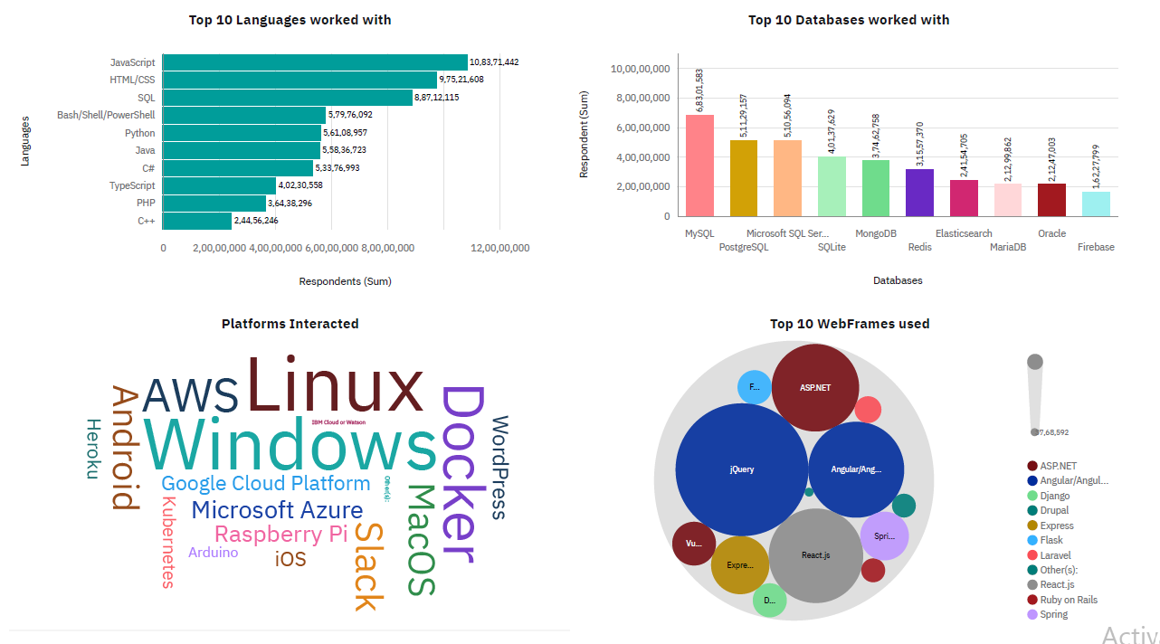
CURRENT TECHNOLOGY USAGE - Dashboard

Slide 13
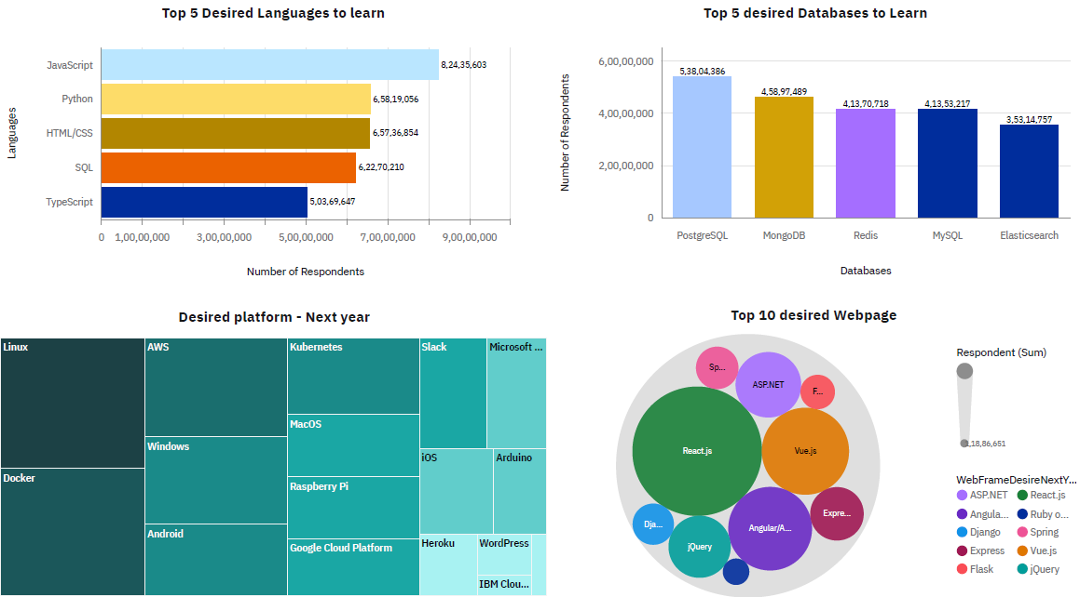
FUTURE TECHNOLOGY TREND - Dashboard

Slide 14
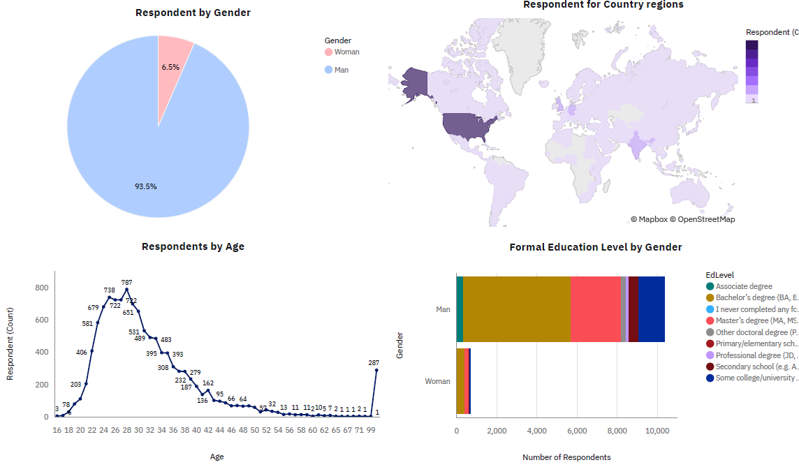
DEMOGRAPHICS- Dashboard

Slide 15
DISCUSSION
Overall findings and implications
Findings
Most people in the IT profession have a bachelor’s degree.
Web development languages are the most popular and on-demand tools in the IT field currently.
The tech sector is majorly filled with young people under 40 years of age.
Implications
It is important for data professionals to develop proficiencies in NoSQL in addition to SQL databases.
Web development is still a very lucrative skill.
Less developed countries need more access to tech trainings and education.

Slide 16

CONCLUSION
It is expedient to stay updated in the tech sector as the trends keep changing over time..

Slide 17
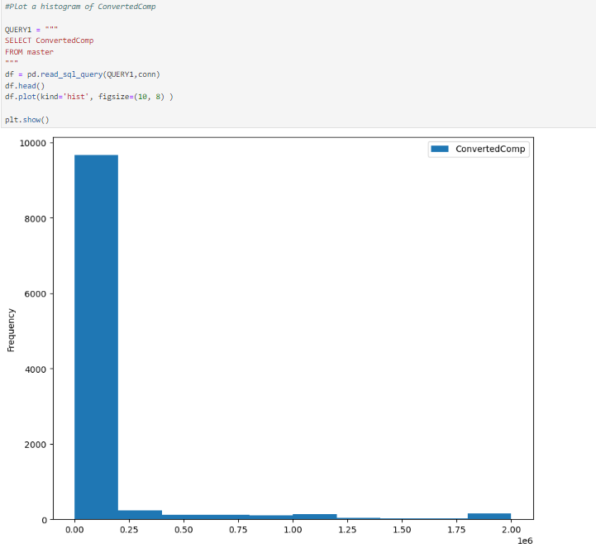
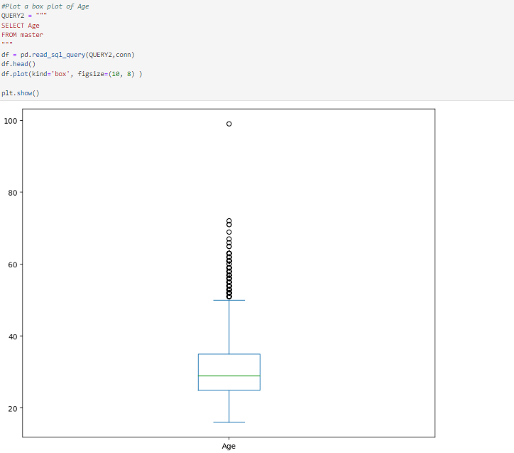
APPENDIX

Slide 18
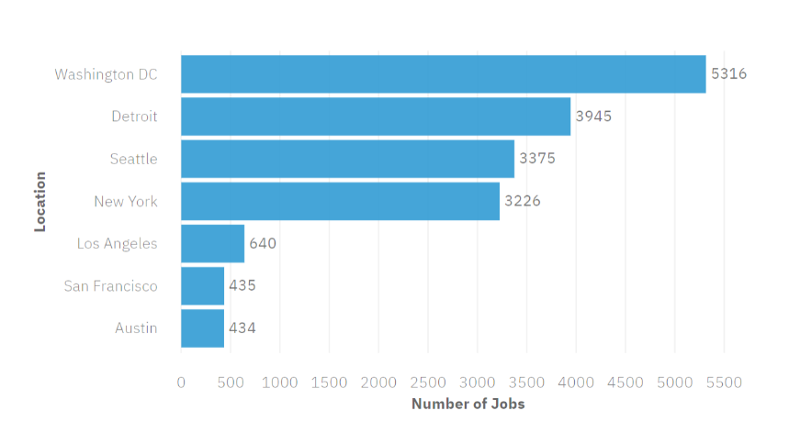
Popular languages
Job postings

